Slide 1


Midyear ECONOMIC OUTLOOK 2012
OUTLOOK 19
Dr. Stephen M. Miller, Director CBER
Lee Business School
University of Nevada, Las Vegas
CBER-LVGEA Outlook 19 Seminar
November 29, 2018
Prepared by
The Center for Business and Economic Research
Lee Business School
University of Nevada, Las Vegas
May 30, 2012

Slide 2


National Outlook

Slide 6
Nevada Outlook

Slide 16
Southern Nevada Outlook

Slide 35
Risks to the Outlook
  Changes in International Growth
    China and emerging market economies
    Euro area
  Monetary or Fiscal Policy Blunders
    Abort growth and cause recession?
  Trade/Tariff War

Slide 36
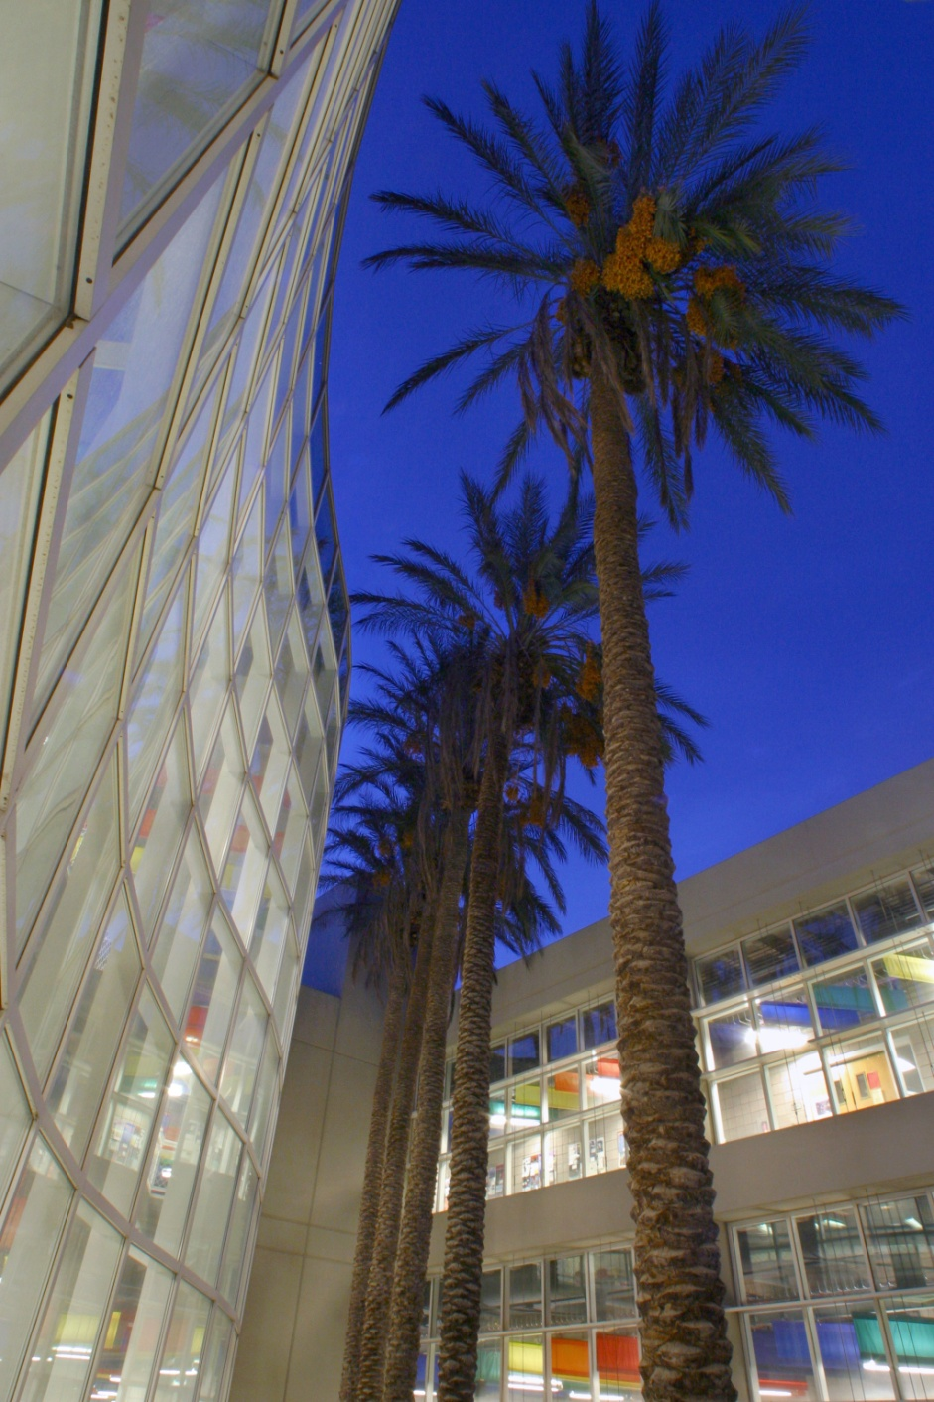
Knowledge within Reach
CBER
http://cber.unlv.edu
Notes:
36

